Slide 1
Chapter 2
Class Discussion
(Hope you are ready!)

Slide 2
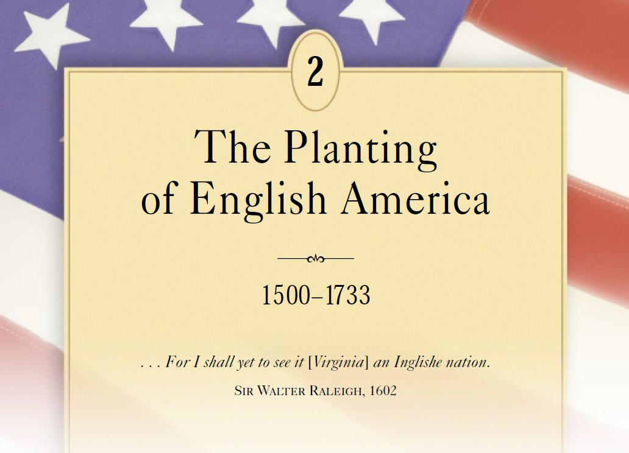

Slide 3
Discussion Question #1
What was the primary purpose of the English settlement of Jamestown, and how successful were the colonists in achieving that goal in the first twenty years?
•Competition with Spain
•Protestant Reformation
•Irish Uprising
•Elizabeth and Philip
•Overpopulation
•Economic Incentives *

Slide 4
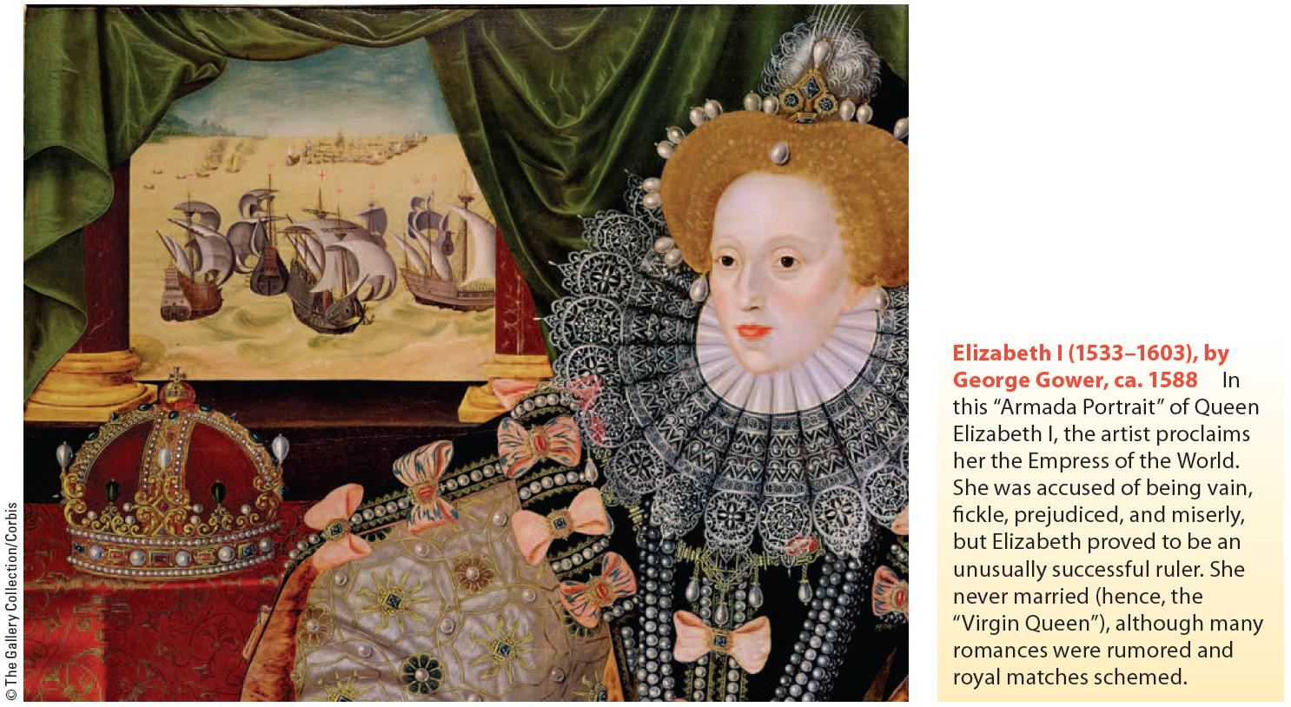

Slide 6
Discussion Question #2
In what ways did the relationship between whites and Native Americans in Virginia establish the pattern for later relations across North America?
•Powhatan’s Confederacy
•Lord De La Warr and Irish Tactics
•First and Second Anglo-Powhatan Wars
•The Three D’s *

Slide 8
Discussion Question #3
What features were common to all of England’s southern colonies, and what features were peculiar to each one?
•Virginia – Child of Tobacco
•Maryland – Catholic Haven
•West Indies – Way Station to Mainland America
•Colonizing the Carolinas
•Georgia – Buffer Colony *

Slide 10
Discussion Question #4
Which was the most important factor shaping the development of England’s southern colonies in the 17th century?
•Indian Relations
•One-Crop Plantation Economy
•Slavery *

Slide 11
Discussion Question #5
Compare and contrast the early colonial empires of Spain and England.
•Motives for Colonization
•Economic Foundations
•Relations with Africans and Native Americans *

