Slide 1
Chapter 3
Class Discussion

Slide 3
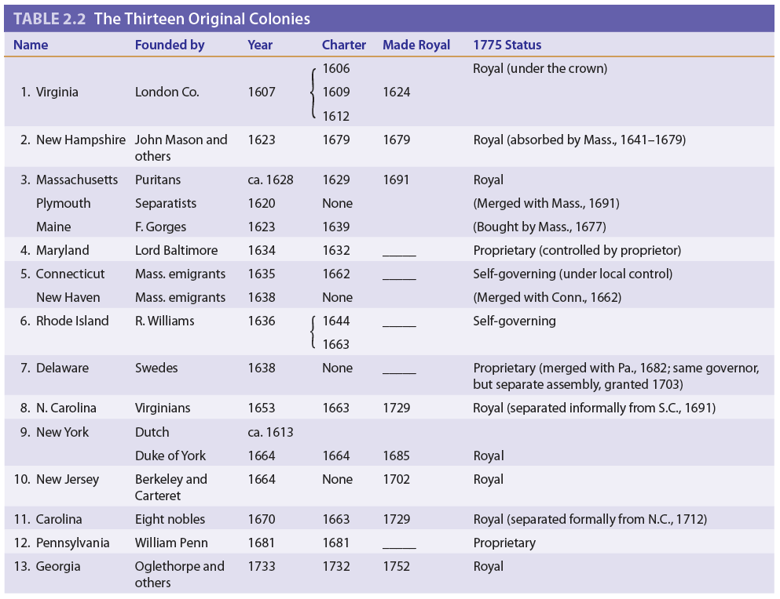

Slide 4
#1: Compare and contrast the New England, Middle, and Southern Colonies.
•Motives for Founding
•Religious and Social Composition
•Economic Foundations
•Political Development *

Slide 5
#2: How did the Puritans’ distinctive religious outlook and church organization shape the politics, society, and culture of Massachusetts Bay and other New England colonies?
Protestant Reformation
Calvinism
Henry VIII
Puritans and Pilgrims
Bible Commonwealth *

Slide 7
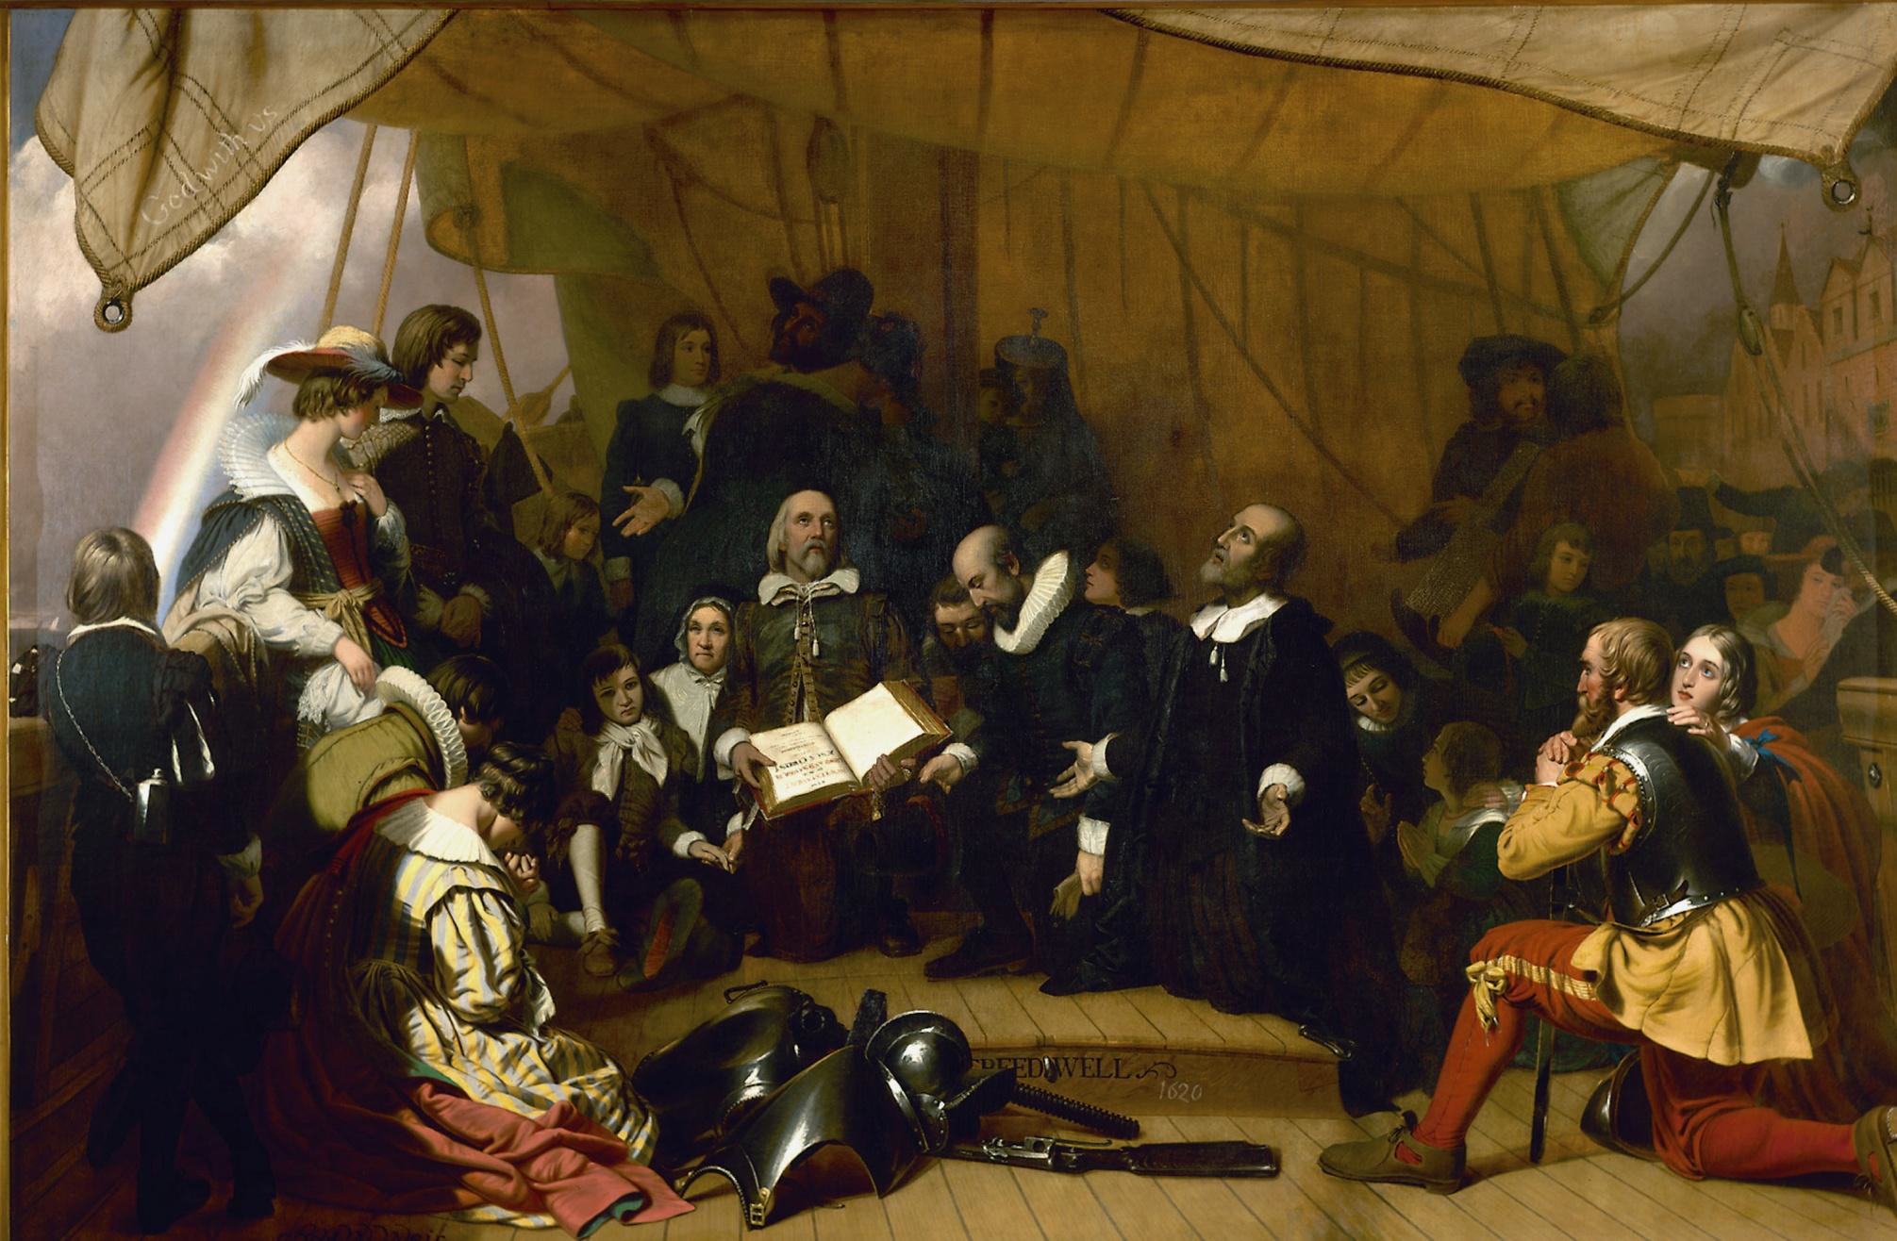

Slide 8
#3: “The dissent from Puritanism was as important in the formation of New England as Puritanism itself.” Do you agree or disagree with the statement? *

Slide 9
#4: Contrast Puritan New England’s policies toward the Native Americans with the initial policies of the Quaker settlers in Pennsylvania. Why was Penn’s policy ultimately unsuccessful?
Spread of English Settlement
Wampanoag Indians
Pequot War
King Philip’s War
Penn’s Holy Experiment – Quakers *

Slide 10
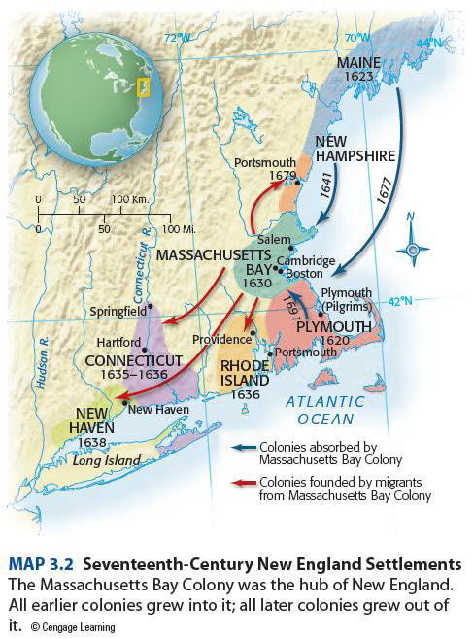

Slide 11
#5: Describe and analyze the English government’s relationship with the colonies in the 17th century. Is the term benign neglect an accurate description of English colonial policy?
New England Confederation
Dominion of New England
Navigation Laws
Glorious Revolution
Salutary “Benign” Neglect *

Slide 12
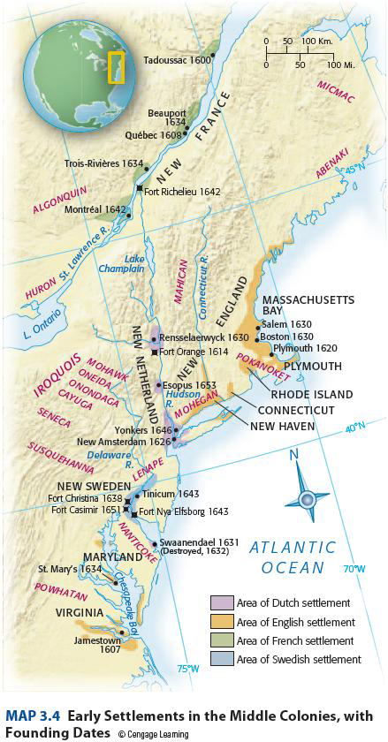
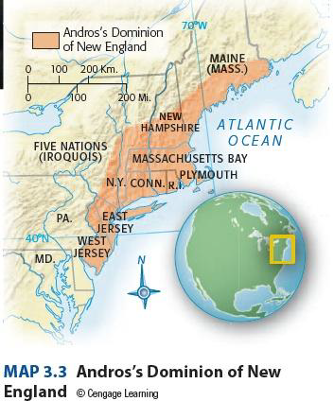

Slide 13
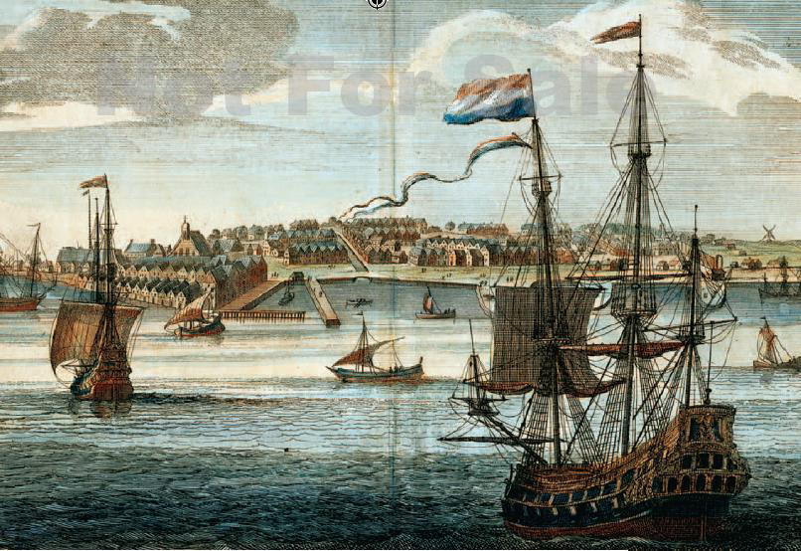

Slide 14
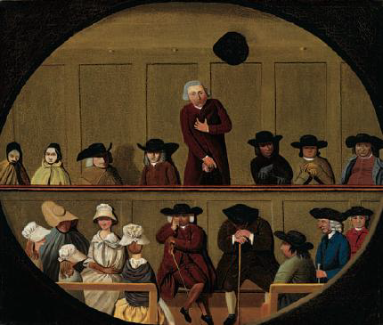
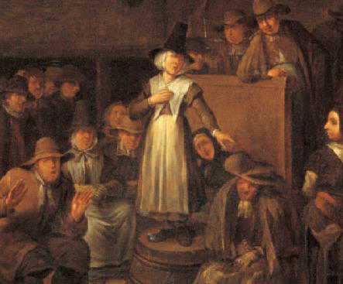

Slide 15
#6: What economic, social, and ethnic conditions typical of the early southern colonies were generally absent in the New England and middle colonies? What characteristics did the middle colonies have that were not generally present in the south? *

